Slide 1
Patterns and trends in adult obesity
A presentation of data on adult obesity in England
Public Health Analysis Directorate
PHA-OHID@dhsc.gov.uk

Slide 2
Introduction
These PowerPoint slides present data from the Health Survey for England on the prevalence of adults (aged 16 and over unless otherwise stated) living with obesity in clear, easy to understand charts and graphics. They have been produced by the Population Health Analysis team in the Public Health Analysis Directorate and can be used freely with acknowledgement to the ‘Office for Health Improvement and Disparities’.
These slides should be useful to practitioners and policy makers working to reduce and prevent overweight and obesity in adults at local, regional and national level. For example they are regularly used to make the case for tackling obesity in presentations to health and wellbeing boards, other committees and to elected members as well as in regional and national conference and workshop presentations.

Slide 3
Health Survey for England (HSE)
https://digital.nhs.uk/data-and-information/publications/statistical/health-survey-for-england
The HSE is a cross-sectional survey which samples a representative proportion of the population to monitor trends in the nation’s health and care. It provides information about adults aged 16 and over, and children aged 0 to 15, living in private households in England. The survey consists of an interview, followed by a visit from a nurse.
The data collection for the 2020 HSE was stopped in March 2020 and no data was published for that year. The 2021 HSE data collection approach differed from previous years due to the COVID-19 pandemic. This included a change in mode, from face-to-face interviewer visits to remote telephone and video interviews. A total of 5,880 adults (aged 16 and over) were interviewed in the 2021 survey, 1,705 adults had a nurse visit.
For most of 2021 it was not possible to directly measure participants’ height and weight because of COVID-19 pandemic precautions. Instead, participants were asked to self-report their height and weight during the telephone interview. The estimates of overweight and obesity prevalence were produced using prediction equations that adjusted self-reported values of height and weight in order to predict measured values of height and weight.
Details of the data collection and the prediction equations can be found in the HSE 2021 Methods report.
Data from the 2021 HSE was limited to only prevalence of overweight and obesity, with no estimates of underweight, healthy weight or severe obesity prevalence. Therefore charts shown in this slide set mostly uses data from the 2019 and previous HSE collections where data from 2021 is not available or not comparable with previous years.

Slide 4
Contents
Adult body mass index classification (slide 5)
Latest data showing adult overweight and obesity by age and sex (slides 6-12)
Trends in adult overweight and obesity (slides 13-17)
Disparities in adult obesity prevalence (slides 18-23)
Waist circumference (slides 24-28)
Health risk using BMI and waist circumference (slides 29-32)
Local authority data (slide 33-34)

Slide 5
Adult body mass index classification
In this presentation of data body mass index (BMI) is classified according to the following table, using BMI thresholds for adults recommended by the National Institute for Health and Care Excellence (NICE).
BMI Range | BMI Category
Less than 18.5kg/m² | Underweight
18.5 to <25kg/m² | Healthy weight
25 to <30kg/m² | Overweight
30kg/m² or more | Obesity
40kg/m² or more | Severe obesity
https://www.nice.org.uk/guidance/cg189/ifp/chapter/Obesity-and-being-overweight

Slide 6
Latest data showing the prevalence of overweight and obesity by age and sex

Slide 7
Prevalence of overweight and obesity
Health Survey for England 2021*
In 2021 almost 6 out of 10 women were overweight or living with obesity (59.0%)
In 2021 almost 7 out of 10 men were overweight or living with obesity (68.6%)
*2021 data not comparable with previous years

Slide 8
Prevalence of obesity
Health Survey for England 2021*
In 2021 almost 3 out of 10 women were living with obesity (26.5%)
In 2021 more than 2 out of 10 men were living with obesity (25.4%)
*2021 data not comparable with previous years

Slide 9
Prevalence of overweight and obesity by age: women
Health Survey for England 2021*
*2021 data not comparable with previous years

Slide 10
Prevalence of overweight and obesity by age: men
Health Survey for England 2021*
*2021 data not comparable with previous years

Slide 11
Adult BMI status by sex
Health Survey for England 2019*
*2021 data not available

Slide 12
Adult BMI status by sex
Health Survey for England 2019*
Obesity 29.1%
Women
Obesity 27.0%
Men
*2021 data not available

Slide 13
Trends in adult overweight and obesity

Slide 14
Prevalence of obesity
Health Survey for England 1993 to 2019* (three-year averages)
*2020 and 2021 data not available

Slide 15
Prevalence of overweight (including obesity)
Health Survey for England 1993 to 2019* (three-year averages)
*2020 and 2021 data not available

Slide 16
Prevalence of severe obesity
Health Survey for England 1993 to 2019* (three-year averages)
*2020 and 2021 data not available

Slide 17
Change in the distribution of BMI in adults aged 18 and over
Health Survey for England 1991 to 1993 and 2016 to 2018
Body mass index (BMI) kg/m²
Men 1991-1993
Women 1991-1993
2019 data will be added to a future report
Men 2016-2018
Women 2016-2018

Slide 18
Disparities in obesity prevalence

Slide 19
Adult obesity prevalence by deprivation
Health Survey for England 2019*
Obesity prevalence is age standardised
95% confidence intervals are shown
* Chart uses the 2019 data as survey participants had measured height and weight

Slide 20
Adult obesity prevalence by household income
Health Survey for England 2017*
Obesity prevalence is age standardised
95% confidence intervals are shown
*Chart uses latest available data

Slide 21
Adult obesity prevalence by ethnic group: Women
Health Survey for England 2011 to 2019* combined
Obesity prevalence is age standardised
95% confidence intervals are shown
* Chart uses the 2019 data as survey participants had measured height and weight

Slide 22
Adult obesity prevalence by ethnic group: Men
Health Survey for England 2011 to 2019* combined
Obesity prevalence is age standardised
95% confidence intervals are shown
* Chart uses the 2019 data as survey participants had measured height and weight

Slide 23
Adult obesity prevalence by region
Health Survey for England 2019*
Obesity prevalence is age standardised
95% confidence intervals are shown
* Chart uses the 2019 data as survey participants had measured height and weight

Slide 24
Waist circumference

Slide 25
Adult mean waist circumference
Health Survey for England 2019*
*2020 and 2021 data not available

Slide 26
Adult very high waist circumference
Health Survey for England 2019*
Women
Men
*2020 and 2021 data not available
Very high waist circumference is taken to be greater than 102cm in men and greater than 88cm in women

Slide 27
Adult very high waist circumference by age and sex
Health Survey for England 2019*
*2020 and 2021 data not available
Very high waist circumference is taken to be greater than 102cm in men and greater than 88cm in women

Slide 28
Trend in very high waist circumference among adults
Health Survey for England 1993 to 2019*
*2020 and 2021 data not available
95% confidence intervals are shown
Very high waist circumference is taken to be greater than 102cm in men and greater than 88cm in women

Slide 29
Health risk using BMI and waist circumference

Slide 30
Health risk categories
Health Survey for England/ NICE

Slide 31
Trend in prevalence of health risk categories
Health Survey for England 1993 to 2019*
*2020 and 2021 data not available
Using combined waist circumference and BMI classification, as recommended by NICE

Slide 32
Change in prevalence of health risk categories
Health Survey for England
1993-1994
2018-2019*
*2020 and 2021 data not available
Using combined waist circumference and BMI classification, as recommended by NICE

Slide 33
Local authority level data

Slide 34
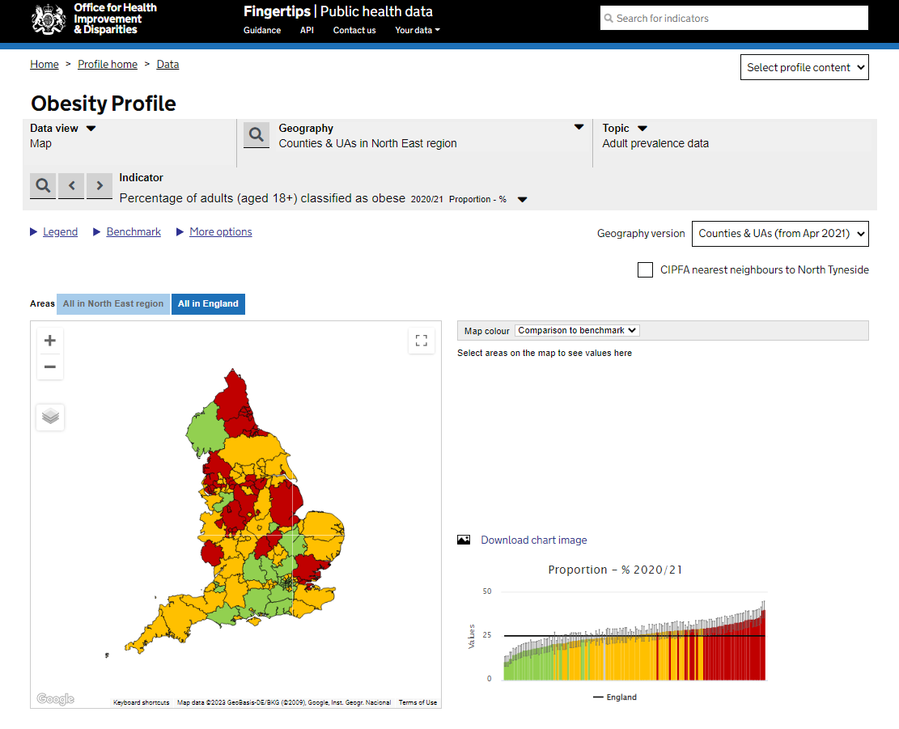
Obesity Profile on Fingertips
The Obesity Profile on Fingertips displays data from the Active Lives adult survey showing prevalence of overweight and obesity by local authority.
Where available, national data is presented split by age, sex, ethnic group, disability, area deprivation, working status, level of education, and socioeconomic class in the Inequalities Data view.
Additional contextual indicators are also included showing local authority data relating to obesity and its determinants.
https://fingertips.phe.org.uk/profile/national-child-measurement-programme

